Slide 1


Bank of Baroda Hackathon - 2022
Technology Partner
Team Name : Team Enciphers
Your team bio : 1) Samyuktha K - SKCT
2) Rithick Krishna S - SKCT
3) Nithish Anand B – SKCT
We are a team of budding tech enthusiasts eager to learn and implement realtime ideas.
Date : 19-09-2022

Slide 2
Problem Statement:
Alternate Authentication
Authentication measures of Caller ID / PIN (personal identification numbers) / Security Questions / Device Signatures are sometime inadequate and intrusive. Identify creative methods of Customer Authentication which can be used on various channels. This should be done without deteriorating the customer experience.
In this modern era, as technology is rapidly developing, online transactions are increasing at a faster pace. This also paves way for the hackers and fraudsters to indulge in looting of people’s money. In order to increase the security and reliability of online banking alternate authentication is the prime necessity, and that’s the reason our team chose this topic.

Slide 3
User Segment & Pain Points
Which user /advertiser segment would be early adopter of your product & why?
As this product is going to be an in-app feature, the end users will be the account holders/customers of the bank.

Slide 4
Pre-Requisite
What are the alternatives/competitive products for the problem you are solving?
The various alternatives for the authentication in the apps are as follows:
1) Verifying the Username and Password
2) Fingerprint detection
3) OTP verification
4) Security questions

Slide 5
Azure tools or resources
1) Azure Cognitive services: Azure Cognitive Services are cloud-based artificial intelligence (AI) services that help to build cognitive intelligence into applications without having direct AI or data science skills or knowledge. 2) Speech services: Speech service adds speech-enabled features to applications. Speech service includes various capabilities like speech-to-text, text-to-speech, speech translation, and many more. 3) Language services: Azure Language service provides several Natural Language Processing (NLP) features to understand and analyze text.

Slide 6
PROPOSED SOLUTION:
Our proposed solution uses Face and Voice recognition in an effective manner to strengthen the security.
(i) * At the time of account creation, the account holder is asked to read the text displayed on the screen to record their voice sample and also their face is recorded for further verification along with the iris.
(ii) When the user initiates a transaction, the user is asked to choose authentication either through password or OTP.
(iii) * The user’s mobile camera is turned on.
* Iris movement of the user is detected to ensure that it is not a photo but a real person and is continuously monitored throughout the transaction.
(iv) The user is expected to tell the password or OTP according to their choice.
(v) Speech to text recognition is used here to check if the OTP or the passwords match, also the accuracy of voice is verified.

Slide 7
Key Differentiators & Adoption Plan
How is your solution better than alternatives and how do you plan to build adoption?
In the traditional authentication systems, there is a possiblility of other people performing the transactions without the knowledge of the account holders. Like for instance, anybody who has access to the account holder’s mobile can easily make transactions using the OTP received or by knowing the password.
But with our solution, we make sure that only the registered user is invloved in the whole of the transaction and the authentication is strengthened.

Slide 8
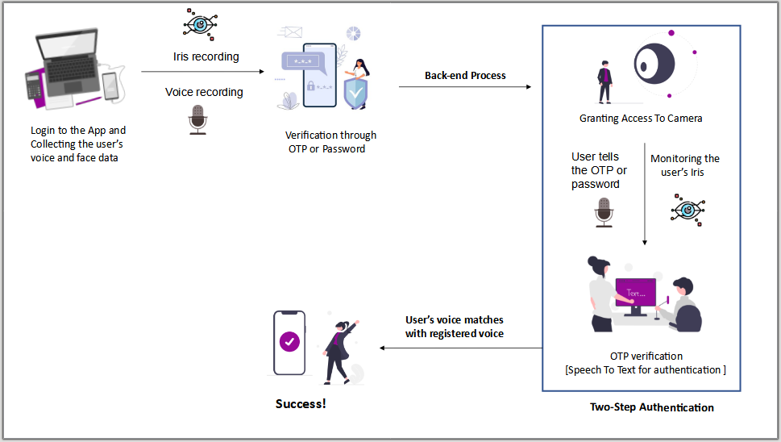
Flow chart:

Slide 9
Thank You
Samyuktha K
Nithish Anand B
Rithick Krishna S

